Slide 1
Rain detection alarm circuit using arduino
IOT Sensors and devices

Slide 2
List of contents
Team members
Abstract
Components Required
Block Diagram
Circuit diagram
Methodology
Arduino ide program
Applications
references

Slide 3
Team members
Batch
3
G charan kumar Naidu 99210042136
K Dhanush 9921004888
J yeshwanth 9921004274
J yugesh babu 9921004275
G pavan sai 99210041195

Slide 4
Abstract
It is used in automobiles when the detector detects the rain it will automatically activates the windshield wipers of the vehicles.
It can also be used in household for harvesting the rain water and increasing ground water storage instead of flowing it into drainage.
So, the main purpose of this project is to prevent the material from rain, can be used in automobiles and in many other purposes. It is an easy and simple reliable circuit which can be constructed at a low cost.

Slide 5
Abstract
Rain alarm project is a simple but very useful project which detects the rain and automatically triggers the alarm or buzzer.
The sensor acts like a simple switch where the switch closes when it rains and is normally open when the rain stops.
As water is basic need in everyone’s life. Saving the water and proper usage is very important. This project will trigger the alarm when it rains so we can make some actions for rain water harvesting and also to save the rain water for using it later for agriculture in fields.

Slide 6
Components Required
Buzzer
Male to Male Jumper Wires
Male to Female jumper Wires
Hard Jumper Wire
Battery clip
Battery 9v
Arduino IDE
Breadboard
Arduino Uno
16x2 LCD Display
Rain Sensor Module
Push Button
10k Variable Resistor
100R Resistor x 3
Green LED & Red LED

Slide 7

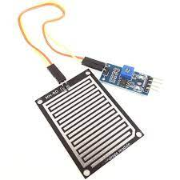
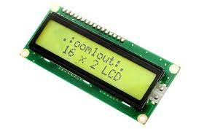
Components Required
Arduino Uno
16x2 LCD Display
Rain Sensor Module

Slide 8
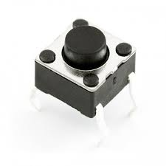
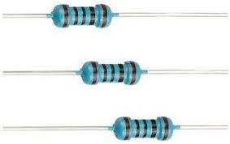
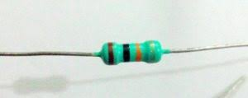
Components Required
Push Button
10k Variable Resistor
100R Resistor x 3

Slide 9
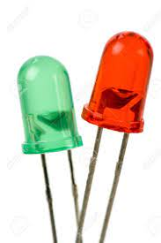
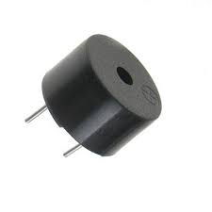
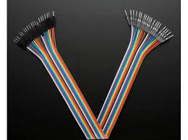
Components Required
Green LED & Red LED
Buzzer
Jumper Wires

Slide 10
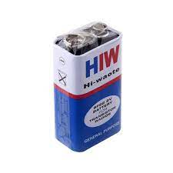
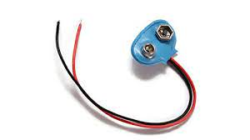

Components Required
Arduino IDE
Battery 9v
Battery clip

Slide 11
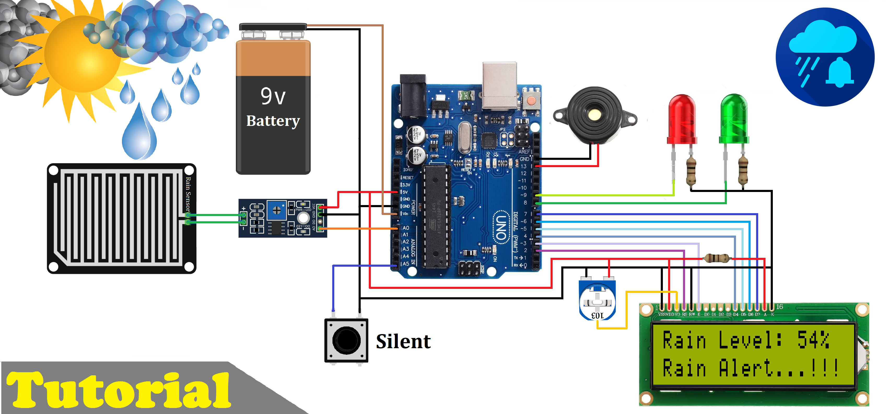
Block Diagram

Slide 12
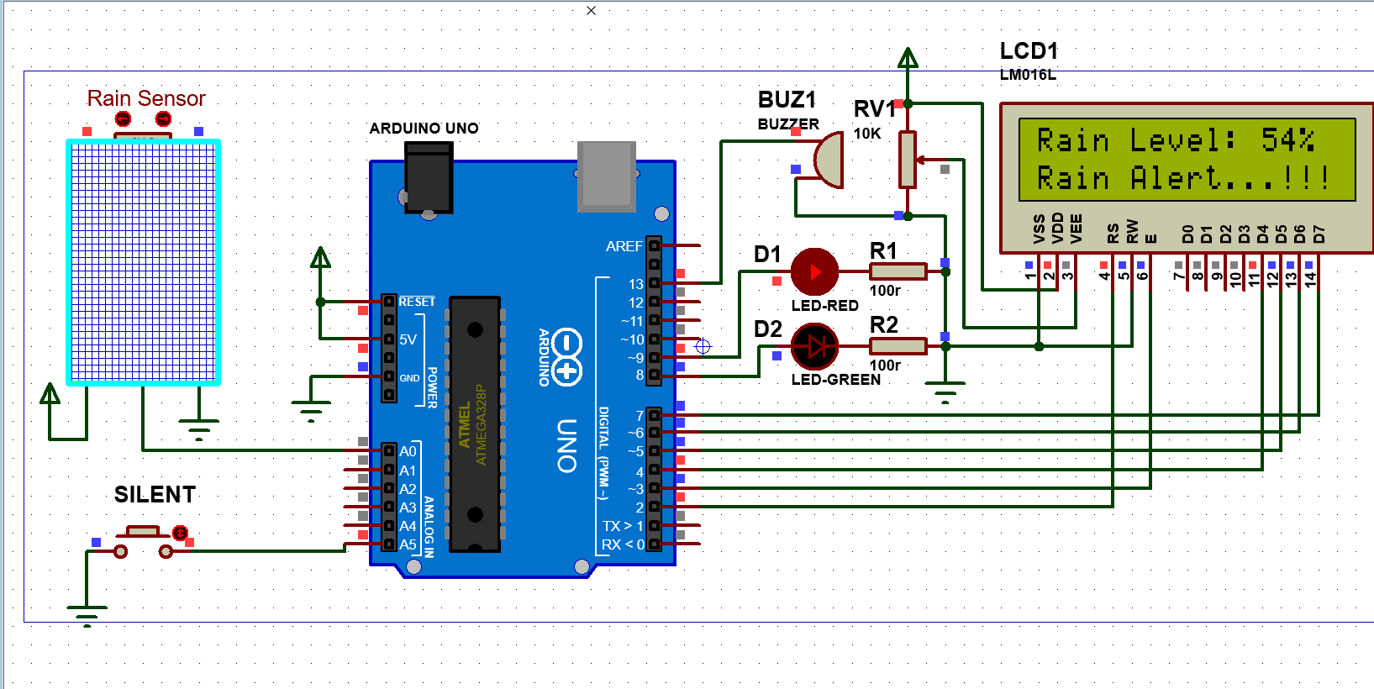
Circuit diagram

Slide 13
methodology
The rain sensor mainly works on the principle of rain Working of the rain sensor module is simple to understand.
During a sunny day, due to the dryness on the rain board module, it offers high resistance to the supply voltage.
This voltage appears on the output pin of the rain board module as 5V. This 5V is read as 1023 if read by an analog pin of the Arduino.
During rain, the rainwater causes an increase in the wetness on the rain board, which in turn results in the decrease in the resistance offered for the supply.
As the resistance decreases gradually, the output voltage starts to decrease. Make connections according to the above circuit diagram.

Slide 14
methodology
When the rain board is fully wet, and the resistance offered by it is minimum, the output voltage will be as low as possible (approx. 0).
This 0V is read as 0 value if read by an analog pin of the Arduino. If the rain board module is partially wet, the output of this rain board module will be with respect to the resistance it offers.
This system works in such a way that, when there is rain, the rainwater acts as a trigger, which switches on the buzzer. In the Rain Drop Sensor Arduino Code, we defined that pins 5, and A0 are buzzer and rainfall.

Slide 15
Arduino ide program
#include <LiquidCrystal.h>
LiquidCrystal lcd(2, 3, 4, 5, 6, 7);
#define sensor_pin A0
int adc_value;
int percent_value;
#define bt_silent A5
int silent=0;
#define G_led 8
#define R_led 9
#define buzzer 13

Slide 16
Arduino ide program
void setup()
{
pinMode(sensor_pin, INPUT);
pinMode(bt_silent, INPUT_PULLUP);
pinMode(R_led,OUTPUT);
pinMode(G_led,OUTPUT);
pinMode(buzzer,OUTPUT);
lcd.begin(16, 2);
lcd.clear();
lcd.setCursor (0,0);
lcd.print(" Welcome To ");
lcd.setCursor (0,1);
lcd.print(" Rain Detector ");
delay(2000);
lcd.clear();
}

Slide 17
Arduino ide program
void loop()
{
adc_value= analogRead(sensor_pin);
percent_value = map(adc_value,0,1023,100,0);
if(digitalRead (bt_silent) == 0)
{
silent = 1;
delay(100);
}
lcd.setCursor(0, 0);
lcd.print("Rain Level: ");
lcd.print(percent_value);
lcd.print("% ");
lcd.setCursor(0, 1);

Slide 18
Arduino ide program
if(percent_value>30)
{
if(silent==0){digitalWrite(buzzer, HIGH);}
lcd.print("Rain Alert...!!!");
digitalWrite(G_led, LOW); // Turn LED off.
digitalWrite(R_led, HIGH); // Turn LED on.
delay(300);
}

Slide 19
Arduino ide program
else
{
silent=0;
lcd.print(".....Normal.....");
digitalWrite(G_led, HIGH); // Turn LED on.
digitalWrite(R_led, LOW); // Turn LED off.
}
digitalWrite(buzzer, LOW);
delay(100);
}

Slide 20
applications
The rain water detector-alarm system will be useful in both domestic and industrial applications. It alerts the users of the presence of rain when itis just about to rain as even the minutest droplets of water triggers it ON.
This project can use as a water preservation device and this is connected to the irrigation system to shut down the system in the event of rainfall.
This can be used to guard the internal parts of an automobile against the rainfall as well as to support the regular windscreen wiper’s mode.

Slide 21
references
www.instructables.com
www.researchgate.net
makezine.com
T. K. Gannavaram V, R. Bejgam, S. B. Keshipeddi, S. Sunkari and V. K. Aluvala, "Conversion of Sound Energy into Electrical Energy in Highly Populated Areas," 2021 6th International Conference on Communication and Electronics Systems (ICCES), 2021, pp. 32-36, doi: 10.1109/ICCES51350.2021.9489219.
T. K. Gannavaram V, R. Bejgam, S. B. Keshipeddi, A. Banda and G. Bollu, "Study of Automobile Safety Technology Development using Vehicular Safety Device (VSD)," 2021 6th International Conference on Inventive Computation Technologies (ICICT), 2021, pp. 240-244, doi: 10.1109/ICICT50816.2021.9358670.

Slide 22

Thank you

